Slide 1
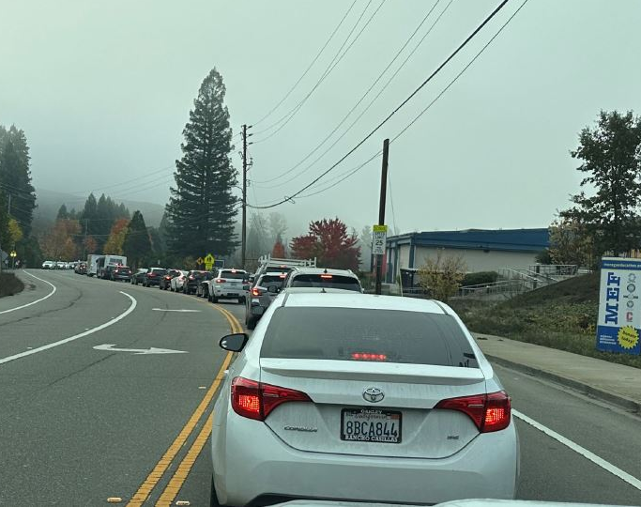

Moraga Rd-Campolindo Dr
Traffic Safety Study
Shawn Knapp, P.E
Public Works Director/ Town Engineer
Office Phone:925-888-7027
Email: sknapp@moraga.ca.us
Yao Miao, Assistant Engineer
Office Phone:925-888-7028
Email: ymiao@moraga.ca.us

Slide 2
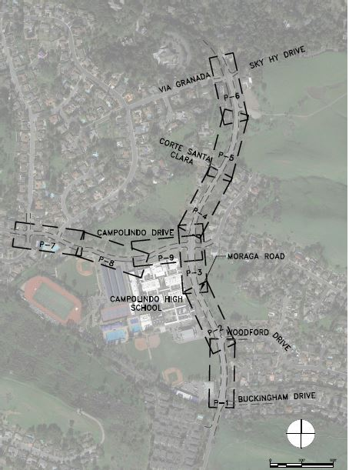
Existing Traffic Safety Concerns
The operation of flashing beacon is not coordinated with adjacent traffic signals on Woodford Dr
Egress issue in Corte Santa Clara during school drop-off and pick-up hours
Sight obstruction when pedestrians across Campolindo Dr
Future traffic impacts from Palos Colorados subdivision development

Slide 3
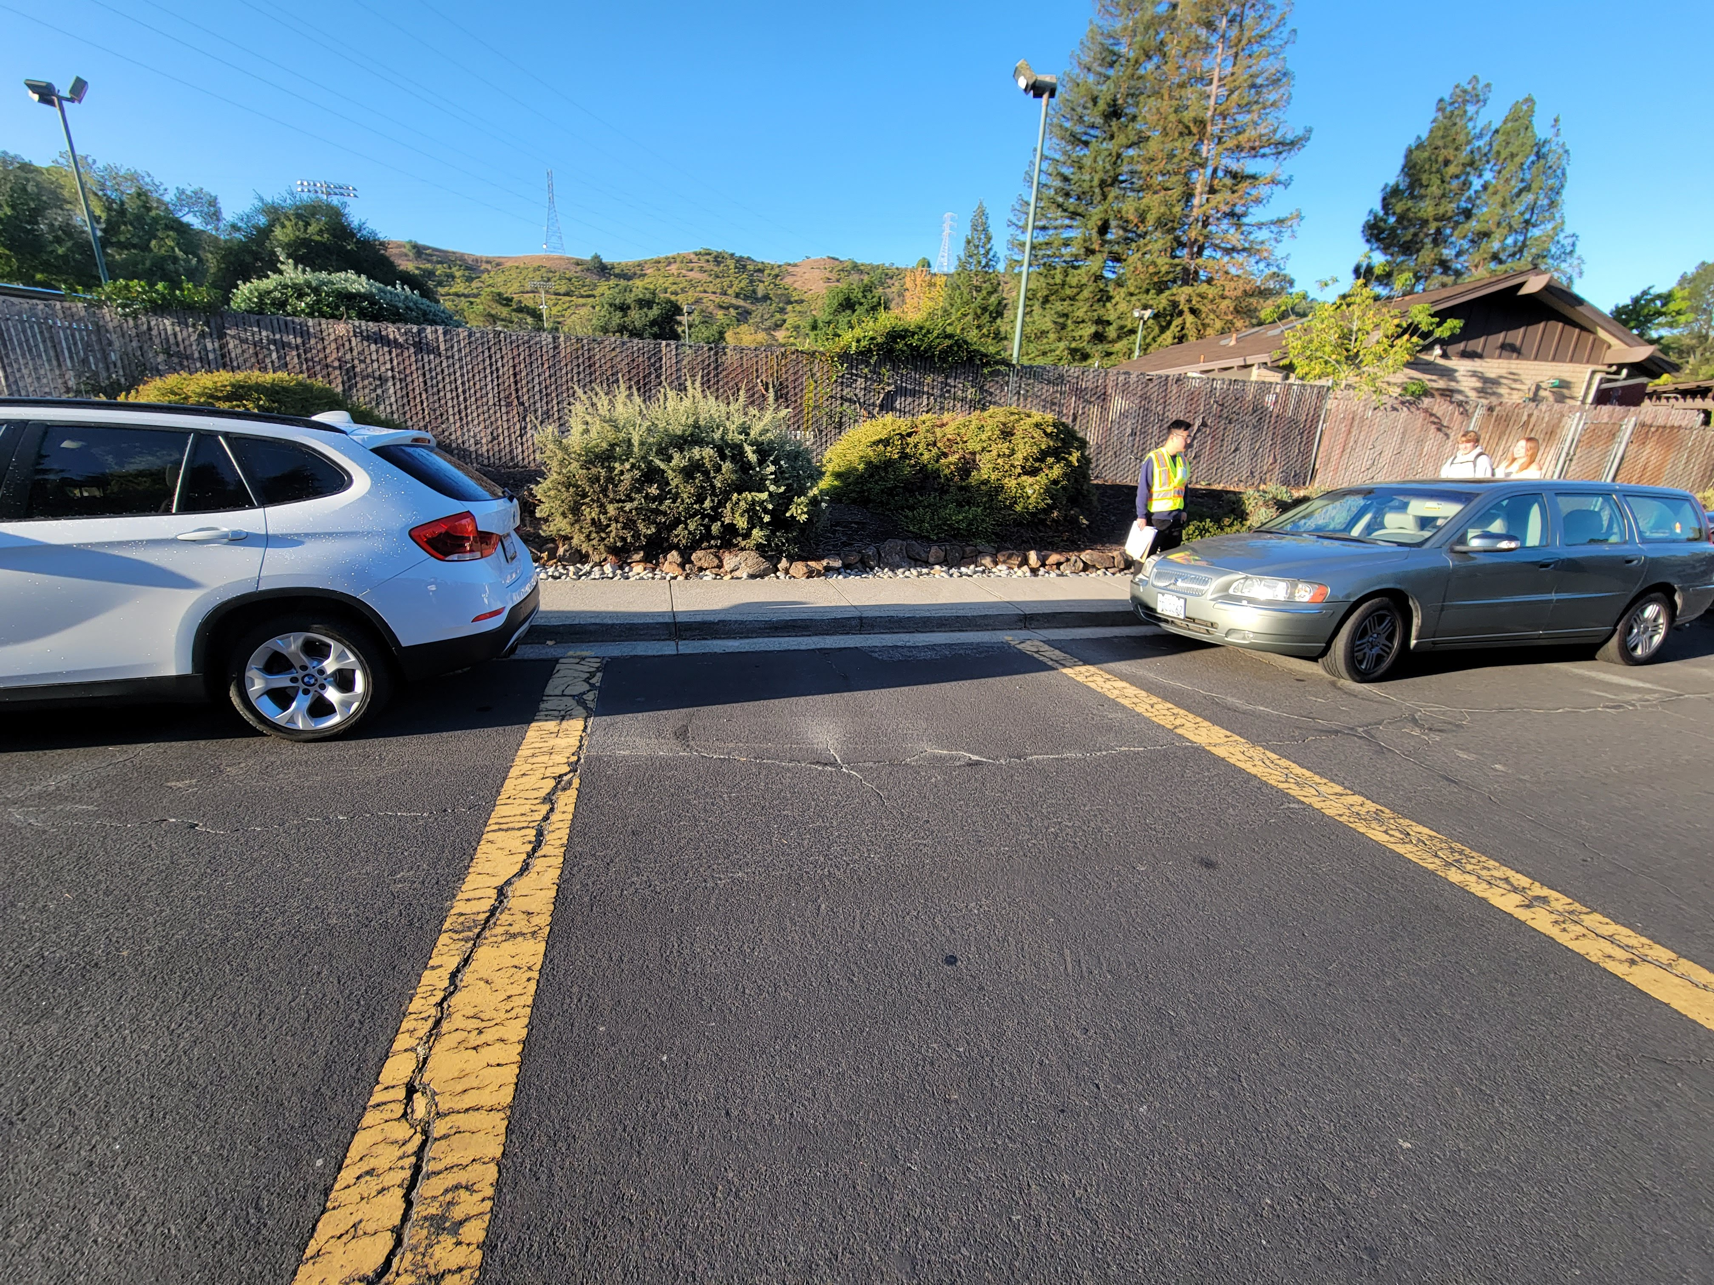
Goals for Traffic Safety on Campolindo Dr
Reduce Congestion on Campolindo Drive
Improve Traffic Safety on Calle La Mesa and Paseo Del Rio Crosswalks
Mitigate Future Traffic Impacts from Palos Colorados Subdivision Development

Slide 4
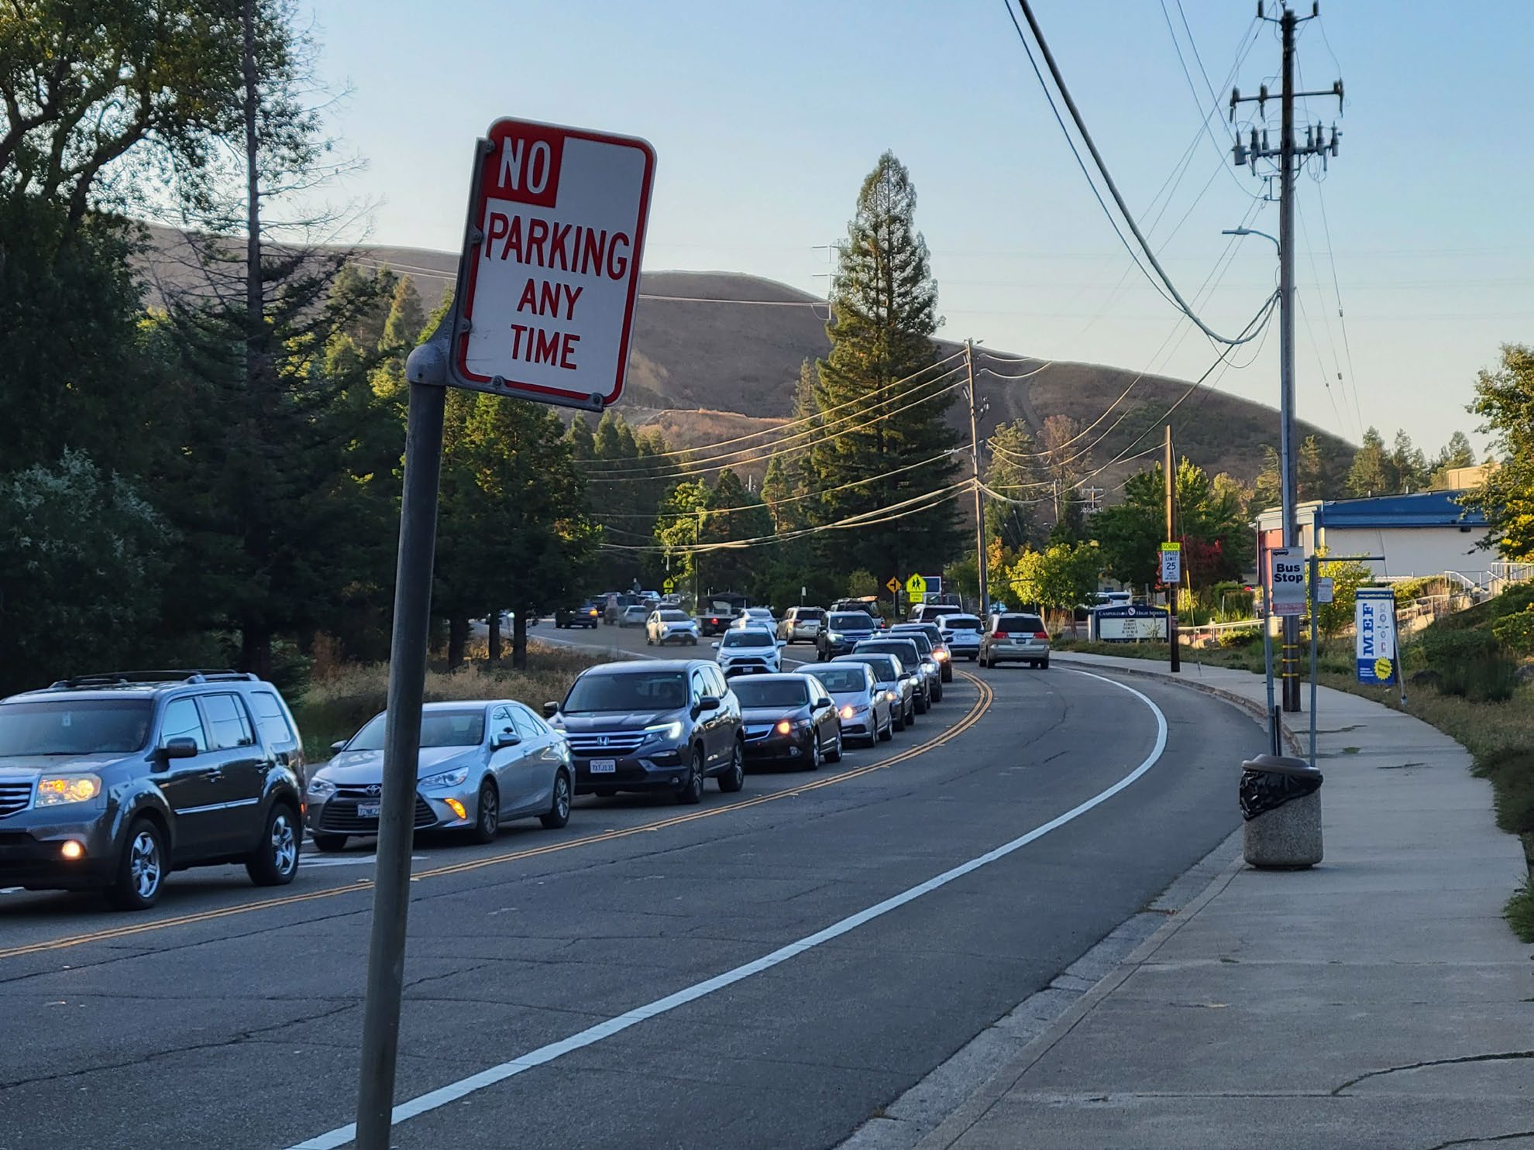
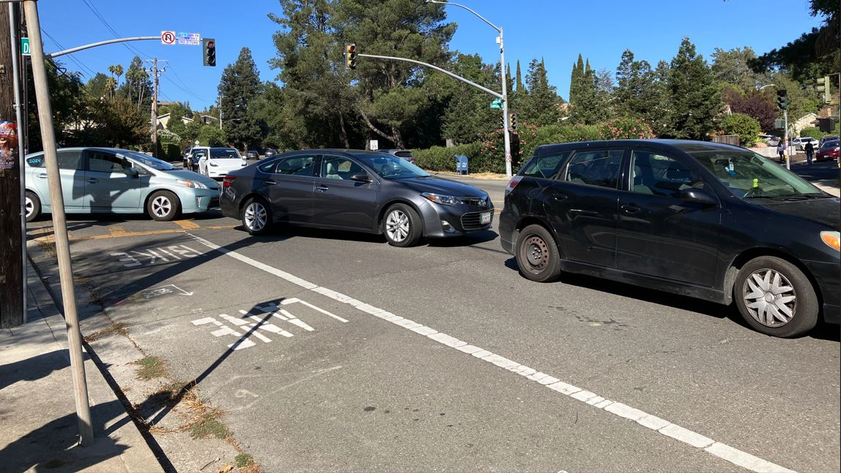
Moraga Rd Congestion
-Campolindo High After School Pick-Up & Drop-off

Slide 5
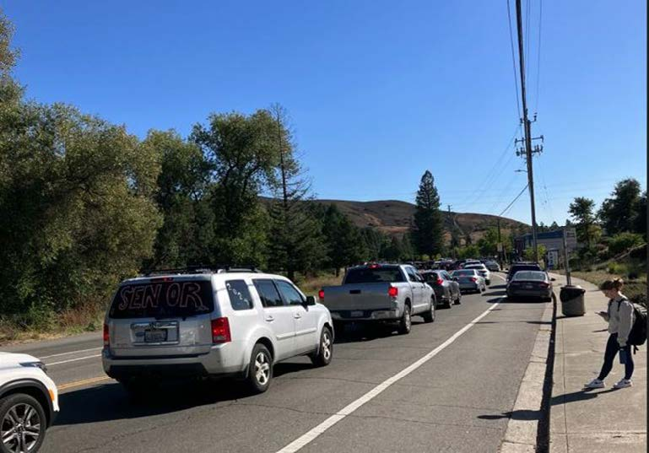
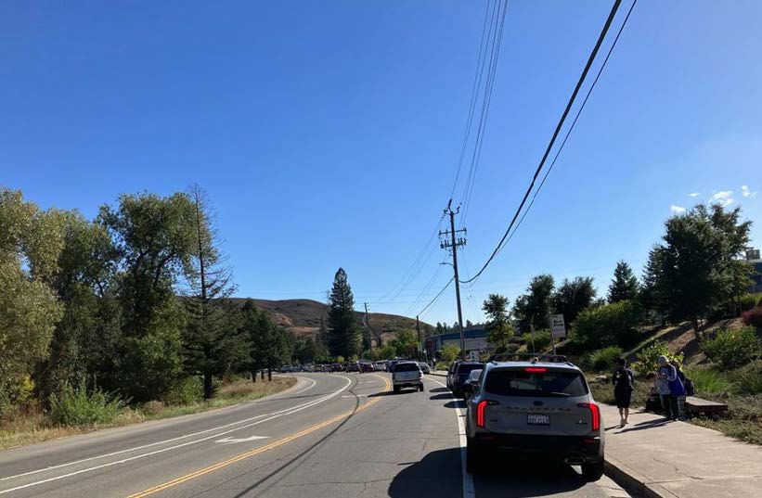
Moraga Rd Congestion
-Campolindo High After School Pick-Up & Drop-off

Slide 6
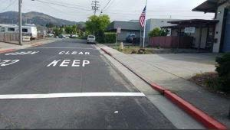
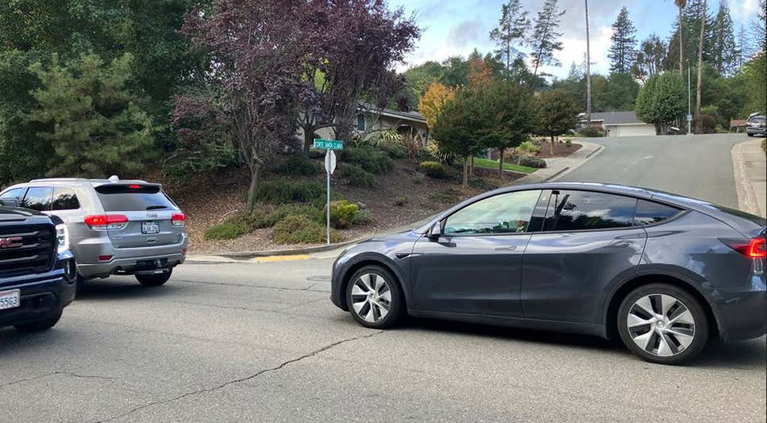

Corte Santa Clara
-Vehicle Backup Blocking Intersection
Possible Solution

Slide 7
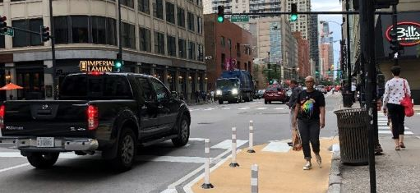
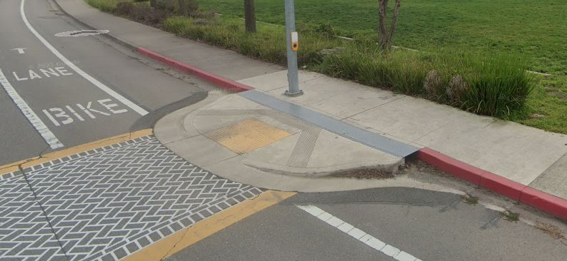
Curb Extension Striping
V.S
Physical Bulb-out
More economic friendly
Quicker time to implement (quick build)
Easy to take off/remove
Curb Extension Striping is more favorable for Quick Implementation!!!

Slide 8
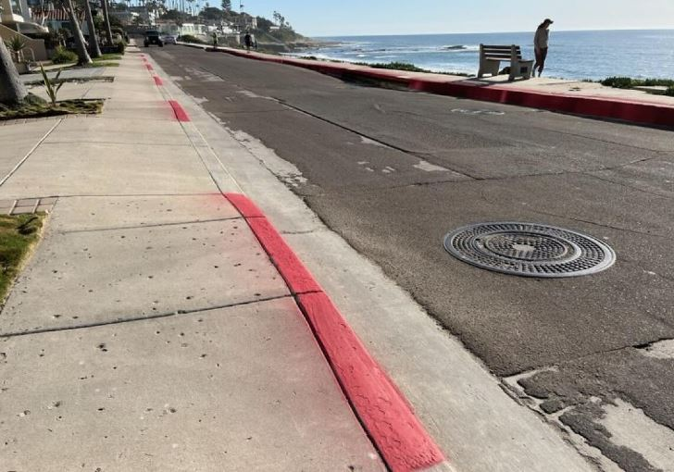
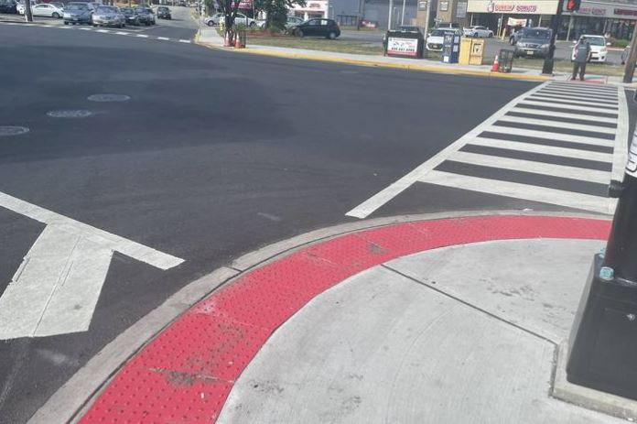
Red Curb Marking Samples

Slide 9
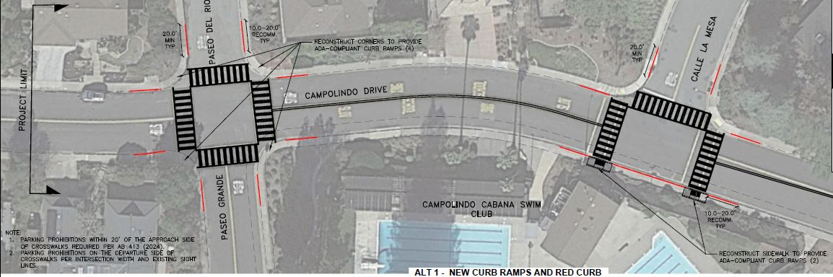
Campolindo Drive Crosswalks
Conceptual Plan- Alternate 1
-New ADA Curb Ramps -High Visibility Crosswalks -Red curb for No Parking

Slide 10
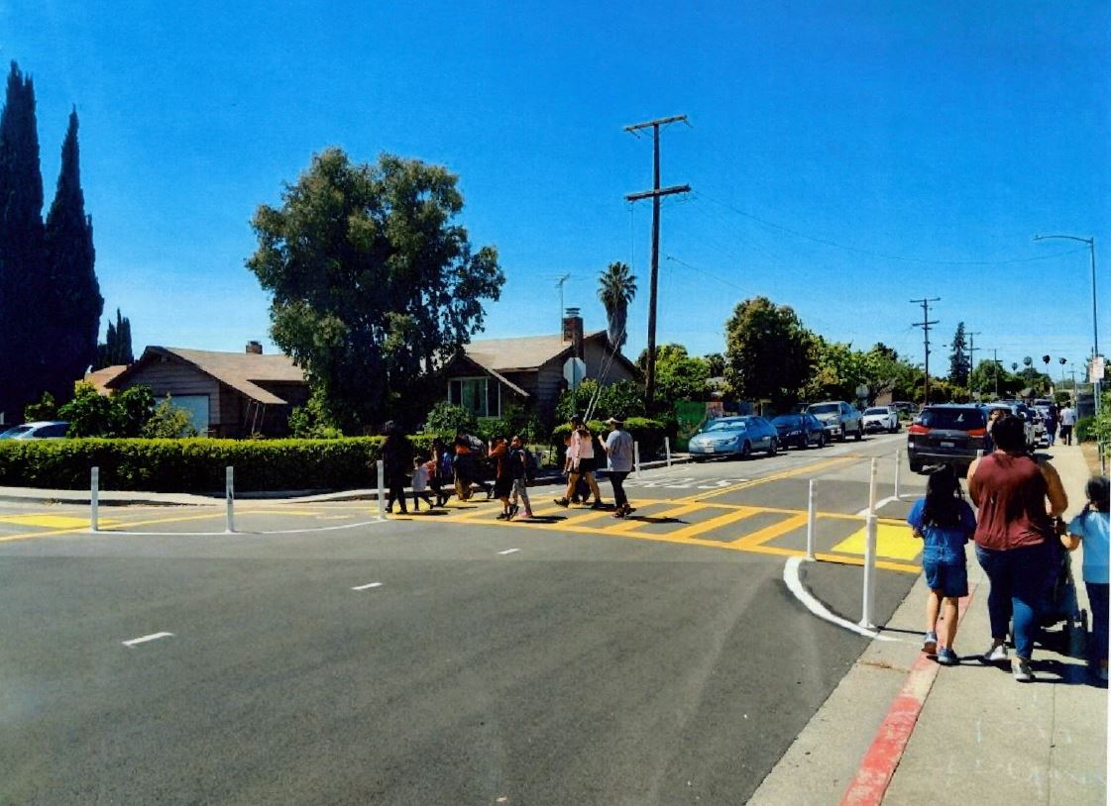
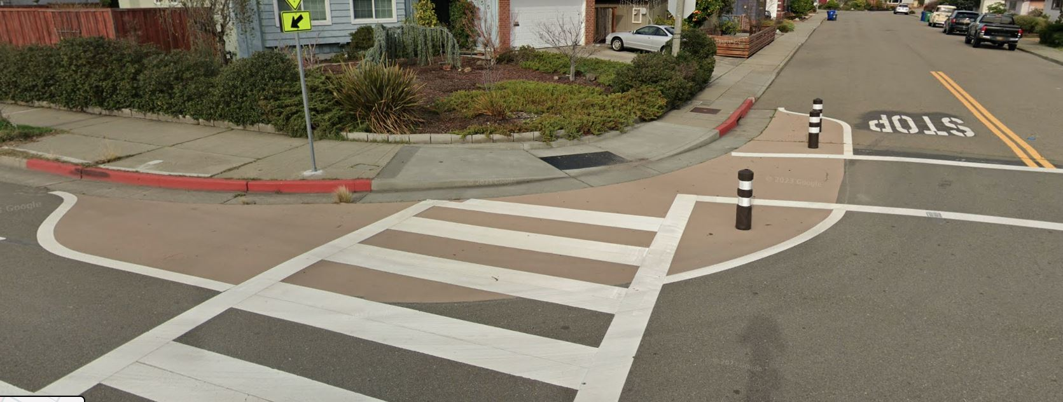
Quick Build Striping Samples

Slide 11
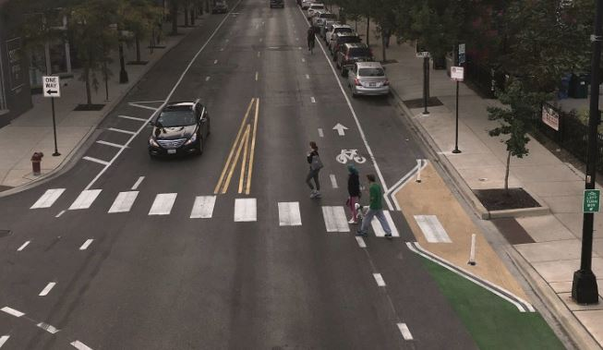
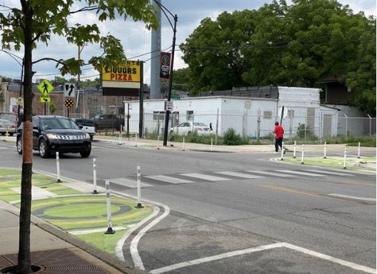
Quick Build Striping Samples

Slide 12
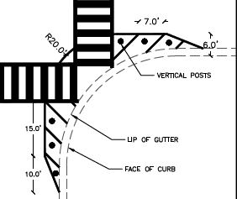
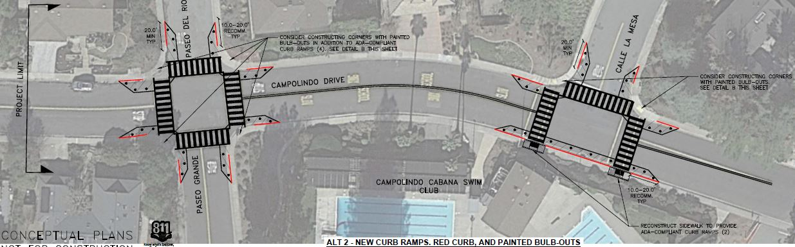
Campolindo Drive Crosswalks
Conceptual Plan- Alternate 2
-New ADA Curb Ramps -High Visibility Crosswalks -Red curb for No Parking -Curb Extension Striping with Plastic Bollards

Slide 13
Thank you!
Moraga Road & Campolindo Drive Traffic Safety Study
Questions and Concerns?

